Slide 1
PROJECT TITLE: BLOOD BANK
Group MEMBERS
NAME | ROLL NO
SREESANKAR S | AM.EN.U4CSE20366
DEVESH KUMAR V V | AM.EN.U4CSE20321
VIGNESH A NAIR | AM.EN.U4CSE20374

Slide 2
Project Abstract:
This project aims to develop a database for enable management of blood bank conveniently and efficiently. This database contains relations where it stores the details of branches of blood bank, donors, receiver etc which also have another relation which stores the transfer details of donor and receiver.
This system allows us to input the details of the receiver and donor and stores it in a database. It also helps us to know the information about the blood transfer among the donor and receiver.

Slide 3
Features
Provides the searching facilities based on various factors like Blood Group, Branch, Stock etc.
Manage the information of Donor and receiver.
Shows the information about the type of Blood.
All the fields such as Blood , Blood Group, Stock are validated and does not take invalid values.
Editing, adding and updating of Records is improved which results in proper resource management of Blood data.

Slide 4
PURPOSE
This project aims to develop an web application for management of blood bank conveniently and efficiently. This project aims to reduce the manual task and allow easy management of the blood transactions and other task related to Blood bank management system.
The project is totally built at administrative end and thus the administrator, donor, receiver can modify the data. It tracks all the details about the Blood Group, Blood Bank, availability.

Slide 5
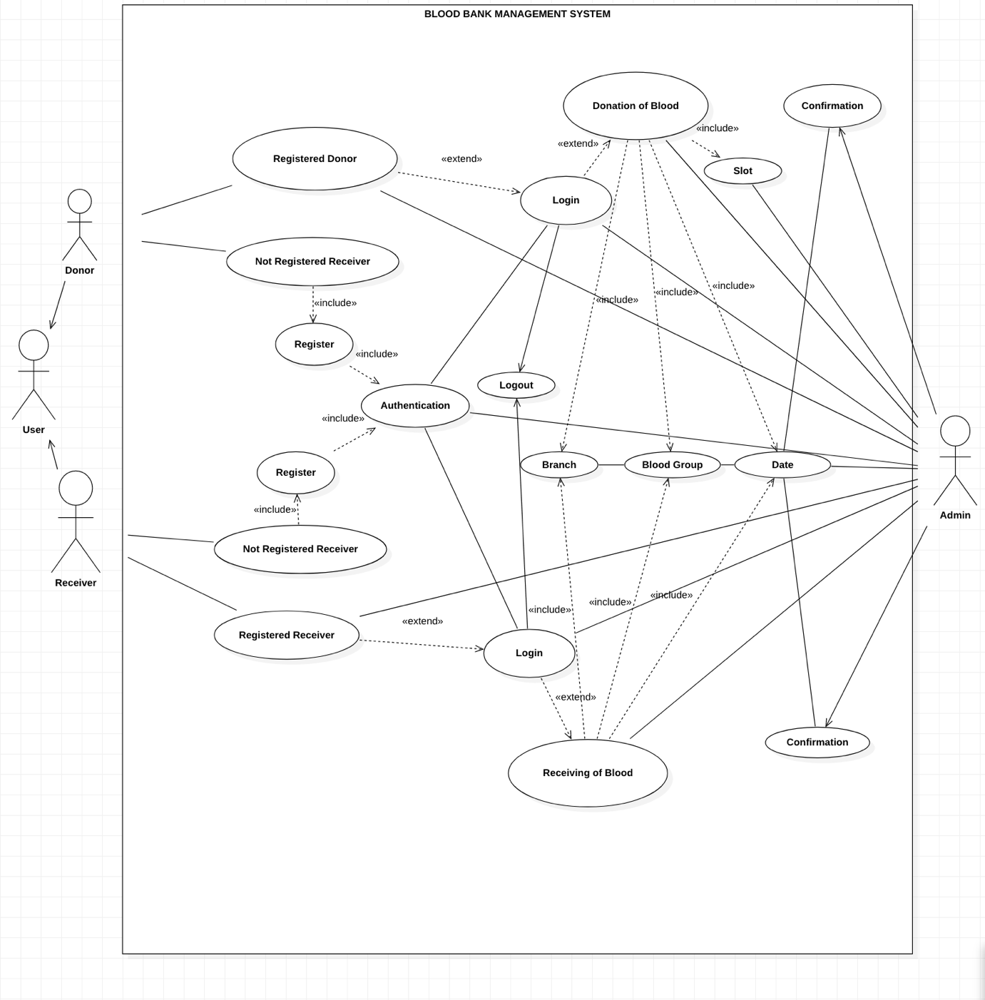
User Case Diagram :-

Slide 6
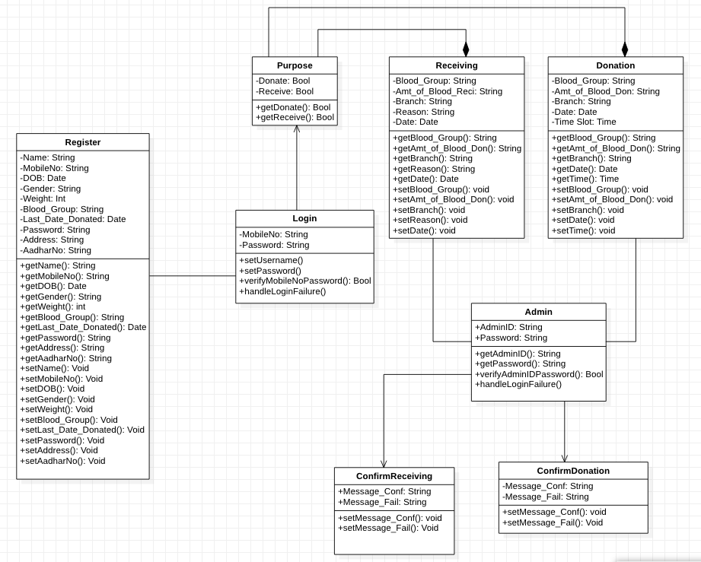
Class Diagram:-

Slide 7
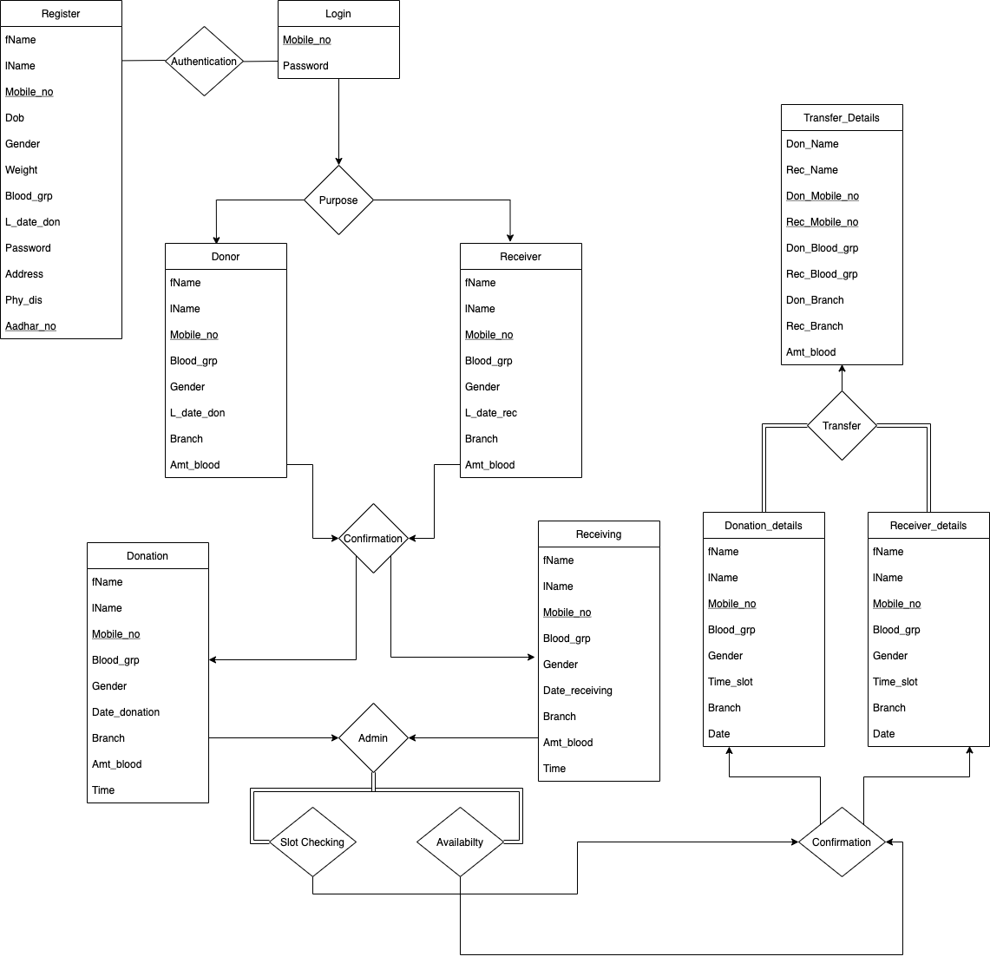
ER DIAGRAM

Slide 8
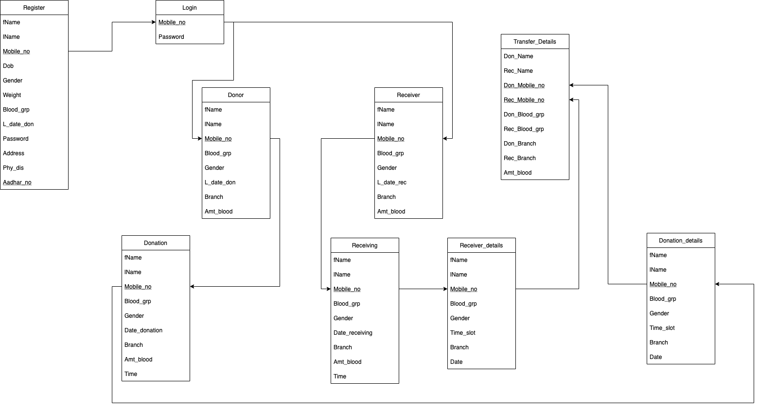
SCHEMA DIAGRAM

Slide 9
RELATIONAL SCHEMA
Register (fName, lName, Mobile_no, Dob, Gender, Weight, Blood_grp, L_date_don, Password, Address, Phy_dis, Aadhar_no)
Login (Mobile_no, Password)
Donor (fName, lName, Mobile_no, Blood_grp, Gender, L_date_don, Branch, Amt_blood)
Receiver (fName, lName, Mobile_no, Blood_grp, Gender, L_date_rec, Branch, Amt_blood)
Donation (fName, lName, Mobile_no, Blood_grp, Gender, Date_donation, Branch, Amt_blood, Time)
Receiving (fName, lName, Mobile_no, Blood_grp, Gender, Date_receiving, Branch, Amt_blood, Time)
Donation_details (fName, lName, Mobile_no, Blood_grp, Gender, Time_slot, Branch, Date)
Receiver_details (fName, lName, Mobile_no, Blood_grp, Gender, Time_slot, Branch, Date)
Transfer_Details (Don_Name, Rec_Name, Don_Mobile_no, Rec_Mobile_no, Don_Blood_grp, Rec_Blood_grp, Don_Branch, Rec_Branch, Amt_blood)

Slide 10
Thank you

